Slide 1
Basic Business Statistics
11th Edition
Chapter 14
Introduction to Multiple Regression

Slide 2
Learning Objectives
In this chapter, you learn:
How to develop a multiple regression model
How to interpret the regression coefficients
How to determine which independent variables to include in the regression model
How to determine which independent variables are more important in predicting a dependent variable
How to use categorical variables in a regression model
How to predict a categorical dependent variable using logistic regression

Slide 3
The Multiple Regression Model
Idea: Examine the linear relationship between
1 dependent (Y) & 2 or more independent variables (X_{i})
Multiple Regression Model with k Independent Variables:
Y-intercept
Population slopes
Random Error

Slide 4
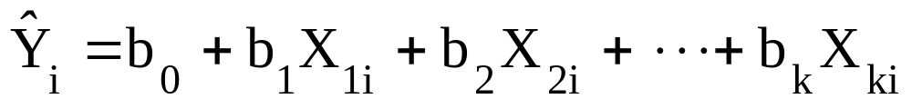
Multiple Regression Equation
The coefficients of the multiple regression model are estimated using sample data
Multiple regression equation with k independent variables:
Estimated
(or predicted)
value of Y
Estimated
intercept
Estimated slope coefficients
In this chapter we will use Excel or Minitab to obtain the regression slope coefficients and other regression summary measures.

Slide 5
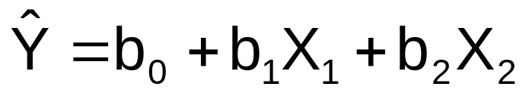
Multiple Regression Equation
(continued)
Two variable model
Y
Slope for variable X₁
X₂
Slope for variable X₂
X₁

Slide 6

Example:
2 Independent Variables
A distributor of frozen dessert pies wants to evaluate factors thought to influence demand
  Dependent variable: Pie sales (units per week)
  Independent variables: Price (in $)
    Advertising ($100’s)
Data are collected for 15 weeks

Slide 7
Pie Sales Example
Week | Pie Sales | Price ($) | Advertising ($100s)
1 | 350 | 5.50 | 3.3
2 | 460 | 7.50 | 3.3
3 | 350 | 8.00 | 3.0
4 | 430 | 8.00 | 4.5
5 | 350 | 6.80 | 3.0
6 | 380 | 7.50 | 4.0
7 | 430 | 4.50 | 3.0
8 | 470 | 6.40 | 3.7
9 | 450 | 7.00 | 3.5
10 | 490 | 5.00 | 4.0
11 | 340 | 7.20 | 3.5
12 | 300 | 7.90 | 3.2
13 | 440 | 5.90 | 4.0
14 | 450 | 5.00 | 3.5
15 | 300 | 7.00 | 2.7
Multiple regression equation:
Sales = b₀ + b₁ (Price)
+ b₂ (Advertising)

Slide 8
Excel Multiple Regression Output
Regression Statistics
Multiple R | 0.72213
R Square | 0.52148
Adjusted R Square | 0.44172
Standard Error | 47.46341
Observations | 15
ANOVA | df | SS | MS | F | Significance F
Regression | 2 | 29460.027 | 14730.013 | 6.53861 | 0.01201
Residual | 12 | 27033.306 | 2252.776
Total | 14 | 56493.333
 | Coefficients | Standard Error | t Stat | P-value | Lower 95% | Upper 95%
Intercept | 306.52619 | 114.25389 | 2.68285 | 0.01993 | 57.58835 | 555.46404
Price | -24.97509 | 10.83213 | -2.30565 | 0.03979 | -48.57626 | -1.37392
Advertising | 74.13096 | 25.96732 | 2.85478 | 0.01449 | 17.55303 | 130.70888

Slide 9
Minitab Multiple Regression Output
The regression equation is
Sales = 307 - 25.0 Price + 74.1 Advertising
Predictor Coef SE Coef T P
Constant 306.50 114.30 2.68 0.020
Price -24.98 10.83 -2.31 0.040
Advertising 74.13 25.97 2.85 0.014
S = 47.4634 R-Sq = 52.1% R-Sq(adj) = 44.2%
Analysis of Variance
Source DF SS MS F P
Regression 2 29460 14730 6.54 0.012
Residual Error 12 27033 2253
Total 14 56493

Slide 10
The Multiple Regression Equation
where
Sales is in number of pies per week
Price is in $
Advertising is in $100’s.
b₁ = -24.975: sales will decrease, on average, by 24.975 pies per week for each $1 increase in selling price, net of the effects of changes due to advertising
b₂ = 74.131: sales will increase, on average, by 74.131 pies per week for each $100 increase in advertising, net of the effects of changes due to price

Slide 11
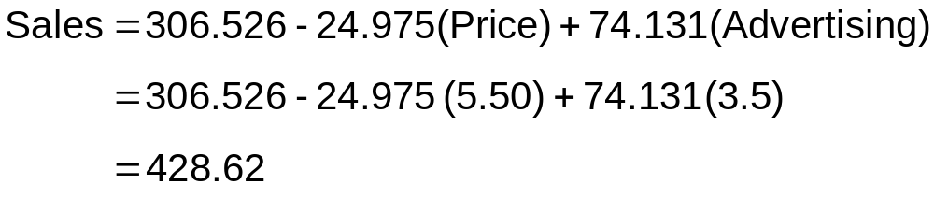
Using The Equation to Make Predictions
Predict sales for a week in which the selling price is $5.50 and advertising is $350:
Note that Advertising is in $100’s, so $350 means that X₂ = 3.5
Predicted sales is 428.62 pies

Slide 12
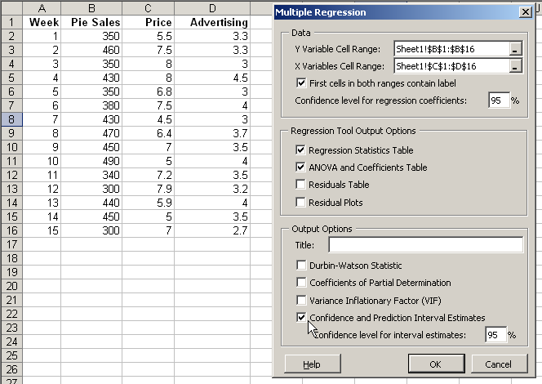
Predictions in Excel using PHStat
PHStat | regression | multiple regression …
Check the “confidence and prediction interval estimates” box

Slide 13
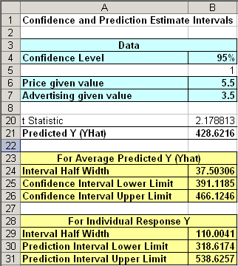
Predictions in PHStat
(continued)
Input values
<
Predicted Y value
Confidence interval for the mean value of Y, given these X values
Prediction interval for an individual Y value, given these X values

Slide 14

Predictions in Minitab
Confidence interval for the mean value of Y, given these X values
Predicted Values for New Observations
New
Obs Fit SE Fit 95% CI 95% PI
1 428.6 17.2 (391.1, 466.1) (318.6, 538.6)
Values of Predictors for New Observations
New
Obs Price Advertising
1 5.50 3.50
Prediction interval for an individual Y value, given these X values
Input values

Slide 15
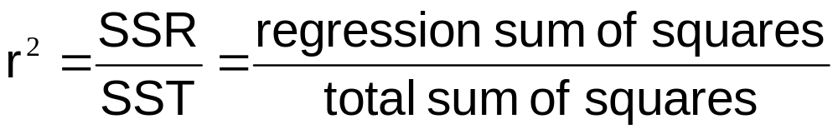
Coefficient of
Multiple Determination
Reports the proportion of total variation in Y explained by all X variables taken together

Slide 16
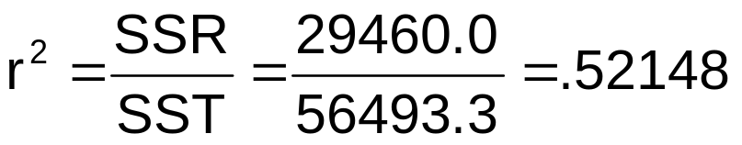
Multiple Coefficient of
Determination In Excel
Regression Statistics
Multiple R | 0.72213
R Square | 0.52148
Adjusted R Square | 0.44172
Standard Error | 47.46341
Observations | 15
ANOVA | df | SS | MS | F | Significance F
Regression | 2 | 29460.027 | 14730.013 | 6.53861 | 0.01201
Residual | 12 | 27033.306 | 2252.776
Total | 14 | 56493.333
 | Coefficients | Standard Error | t Stat | P-value | Lower 95% | Upper 95%
Intercept | 306.52619 | 114.25389 | 2.68285 | 0.01993 | 57.58835 | 555.46404
Price | -24.97509 | 10.83213 | -2.30565 | 0.03979 | -48.57626 | -1.37392
Advertising | 74.13096 | 25.96732 | 2.85478 | 0.01449 | 17.55303 | 130.70888
52.1% of the variation in pie sales is explained by the variation in price and advertising

Slide 17
Multiple Coefficient of
Determination In Minitab
The regression equation is
Sales = 307 - 25.0 Price + 74.1 Advertising
Predictor Coef SE Coef T P
Constant 306.50 114.30 2.68 0.020
Price -24.98 10.83 -2.31 0.040
Advertising 74.13 25.97 2.85 0.014
S = 47.4634 R-Sq = 52.1% R-Sq(adj) = 44.2%
Analysis of Variance
Source DF SS MS F P
Regression 2 29460 14730 6.54 0.012
Residual Error 12 27033 2253
Total 14 56493
52.1% of the variation in pie sales is explained by the variation in price and advertising

Slide 18
Adjusted r²
r² never decreases when a new X variable is added to the model
  This can be a disadvantage when comparing models
What is the net effect of adding a new variable?
  We lose a degree of freedom when a new X variable is added
  Did the new X variable add enough explanatory power to offset the loss of one degree of freedom?

Slide 19
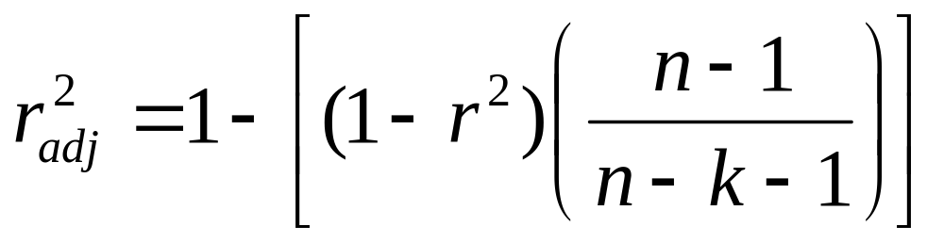
Adjusted r²
(continued)
Shows the proportion of variation in Y explained by all X variables adjusted for the number of X variables used
  (where n = sample size, k = number of independent variables)
  Penalize excessive use of unimportant independent variables
  Smaller than r²
  Useful in comparing among models

Slide 20
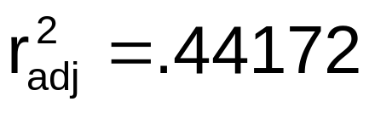
Adjusted r² in Excel
Regression Statistics
Multiple R | 0.72213
R Square | 0.52148
Adjusted R Square | 0.44172
Standard Error | 47.46341
Observations | 15
ANOVA | df | SS | MS | F | Significance F
Regression | 2 | 29460.027 | 14730.013 | 6.53861 | 0.01201
Residual | 12 | 27033.306 | 2252.776
Total | 14 | 56493.333
 | Coefficients | Standard Error | t Stat | P-value | Lower 95% | Upper 95%
Intercept | 306.52619 | 114.25389 | 2.68285 | 0.01993 | 57.58835 | 555.46404
Price | -24.97509 | 10.83213 | -2.30565 | 0.03979 | -48.57626 | -1.37392
Advertising | 74.13096 | 25.96732 | 2.85478 | 0.01449 | 17.55303 | 130.70888
44.2% of the variation in pie sales is explained by the variation in price and advertising, taking into account the sample size and number of independent variables

Slide 21
Adjusted r² in Minitab
The regression equation is
Sales = 307 - 25.0 Price + 74.1 Advertising
Predictor Coef SE Coef T P
Constant 306.50 114.30 2.68 0.020
Price -24.98 10.83 -2.31 0.040
Advertising 74.13 25.97 2.85 0.014
S = 47.4634 R-Sq = 52.1% R-Sq(adj) = 44.2%
Analysis of Variance
Source DF SS MS F P
Regression 2 29460 14730 6.54 0.012
Residual Error 12 27033 2253
Total 14 56493
44.2% of the variation in pie sales is explained by the variation in price and advertising, taking into account the sample size and number of independent variables

Slide 22
Is the Model Significant?
F Test for Overall Significance of the Model
Shows if there is a linear relationship between all of the X variables considered together and Y
Use F-test statistic
Hypotheses:
  H₀: β₁ = β₂ = … = β_{k} = 0 (no linear relationship)
  H₁: at least one β_{i} ≠ 0 (at least one independent
  variable affects Y)

Slide 23
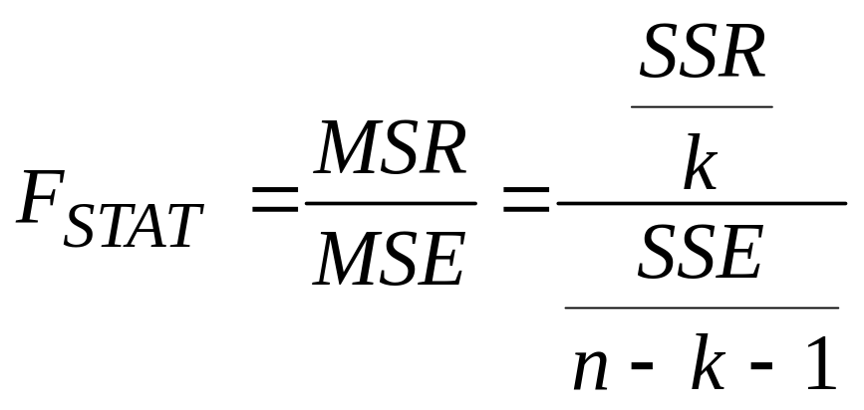
F Test for Overall Significance
Test statistic:
where F_{STAT} has numerator d.f. = k and
denominator d.f. = (n – k - 1)

Slide 24
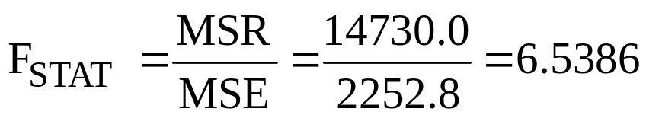
F Test for Overall Significance In Excel
(continued)
Regression Statistics
Multiple R | 0.72213
R Square | 0.52148
Adjusted R Square | 0.44172
Standard Error | 47.46341
Observations | 15
ANOVA | df | SS | MS | F | Significance F
Regression | 2 | 29460.027 | 14730.013 | 6.53861 | 0.01201
Residual | 12 | 27033.306 | 2252.776
Total | 14 | 56493.333
 | Coefficients | Standard Error | t Stat | P-value | Lower 95% | Upper 95%
Intercept | 306.52619 | 114.25389 | 2.68285 | 0.01993 | 57.58835 | 555.46404
Price | -24.97509 | 10.83213 | -2.30565 | 0.03979 | -48.57626 | -1.37392
Advertising | 74.13096 | 25.96732 | 2.85478 | 0.01449 | 17.55303 | 130.70888
With 2 and 12 degrees of freedom
P-value for the F Test

Slide 25
F Test for Overall Significance In Minitab
The regression equation is
Sales = 307 - 25.0 Price + 74.1 Advertising
Predictor Coef SE Coef T P
Constant 306.50 114.30 2.68 0.020
Price -24.98 10.83 -2.31 0.040
Advertising 74.13 25.97 2.85 0.014
S = 47.4634 R-Sq = 52.1% R-Sq(adj) = 44.2%
Analysis of Variance
Source DF SS MS F P
Regression 2 29460 14730 6.54 0.012
Residual Error 12 27033 2253
Total 14 56493
With 2 and 12 degrees of freedom
P-value for the F Test

Slide 26
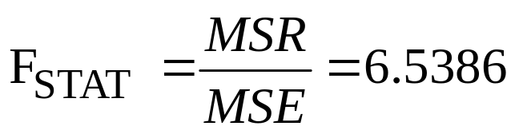
F Test for Overall Significance
(continued)
H₀: β₁ = β₂ = 0
H₁: β₁ and β₂ not both zero
α = .05
df₁= 2 df₂ = 12
Test Statistic:
Decision:
Conclusion:
Critical Value:
F_{0.05} = 3.885
Since F_{STAT} test statistic is in the rejection region (p-value < .05), reject H₀
α = .05
0
F
There is evidence that at least one independent variable affects Y
Do not
reject H₀
Reject H₀
F_{0.05} = 3.885

Slide 27
Residuals in Multiple Regression
Two variable model
Y
Sample observation
Y_{i}
Residual = e_{i} = (Y_{i} – Y_{i})
<
<
Y_{i}
x_{2i}
X₂
x_{1i}
The best fit equation is found by minimizing the sum of squared errors, Σe²
X₁

Slide 28
Multiple Regression Assumptions
Errors (residuals) from the regression model:
<
e_{i} = (Y_{i} – Y_{i})
Assumptions:
The errors are normally distributed
Errors have a constant variance
The model errors are independent

Slide 29
Residual Plots Used in Multiple Regression
These residual plots are used in multiple regression:
  Residuals vs. Y_{i}
  Residuals vs. X_{1i}
  Residuals vs. X_{2i}
  Residuals vs. time (if time series data)
<
Use the residual plots to check for violations of regression assumptions

Slide 30
Are Individual Variables Significant?
Use t tests of individual variable slopes
Shows if there is a linear relationship between the variable X_{j} and Y holding constant the effects of other X variables
Hypotheses:
  H₀: β_{j} = 0 (no linear relationship)
  H₁: β_{j} ≠ 0 (linear relationship does exist
  between X_{j} and Y)

Slide 31
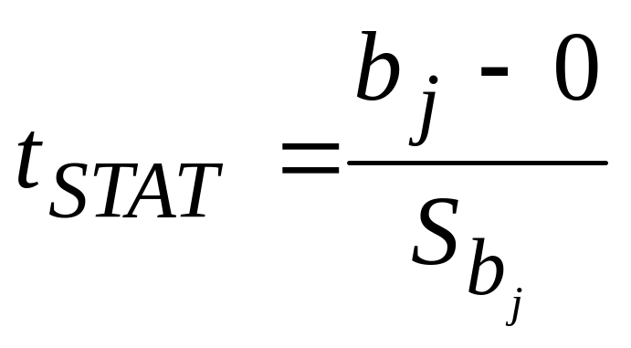
Are Individual Variables Significant?
(continued)
  H₀: β_{j} = 0 (no linear relationship)
  H₁: β_{j} ≠ 0 (linear relationship does exist
  between X_{j} and Y)
  Test Statistic:
  (df = n – k – 1)

Slide 32
Are Individual Variables Significant? Excel Output
(continued)
Regression Statistics
Multiple R | 0.72213
R Square | 0.52148
Adjusted R Square | 0.44172
Standard Error | 47.46341
Observations | 15
ANOVA | df | SS | MS | F | Significance F
Regression | 2 | 29460.027 | 14730.013 | 6.53861 | 0.01201
Residual | 12 | 27033.306 | 2252.776
Total | 14 | 56493.333
 | Coefficients | Standard Error | t Stat | P-value | Lower 95% | Upper 95%
Intercept | 306.52619 | 114.25389 | 2.68285 | 0.01993 | 57.58835 | 555.46404
Price | -24.97509 | 10.83213 | -2.30565 | 0.03979 | -48.57626 | -1.37392
Advertising | 74.13096 | 25.96732 | 2.85478 | 0.01449 | 17.55303 | 130.70888
t Stat for Price is t_{STAT} = -2.306, with p-value .0398
t Stat for Advertising is t_{STAT} = 2.855, with p-value .0145

Slide 33
Are Individual Variables Significant? Minitab Output
The regression equation is
Sales = 307 - 25.0 Price + 74.1 Advertising
Predictor Coef SE Coef T P
Constant 306.50 114.30 2.68 0.020
Price -24.98 10.83 -2.31 0.040
Advertising 74.13 25.97 2.85 0.014
S = 47.4634 R-Sq = 52.1% R-Sq(adj) = 44.2%
Analysis of Variance
Source DF SS MS F P
Regression 2 29460 14730 6.54 0.012
Residual Error 12 27033 2253
Total 14 56493
t Stat for Price is t_{STAT} = -2.306, with p-value .0398
t Stat for Advertising is t_{STAT} = 2.855, with p-value .0145

Slide 34
Inferences about the Slope: t Test Example
From the Excel and Minitab output:
H₀: β_{j} = 0
H₁: β_{j} ≠ 0
For Price t_{STAT} = -2.306, with p-value .0398
For Advertising t_{STAT} = 2.855, with p-value .0145
d.f. = 15-2-1 = 12
= .05
t_{α/2} = 2.1788
The test statistic for each variable falls in the rejection region (p-values < .05)
Decision:
Conclusion:
α/2=.025
α/2=.025
Reject H₀ for each variable
There is evidence that both Price and Advertising affect pie sales at α = .05
Reject H₀
Do not reject H₀
Reject H₀
-t_{α/2}
t_{α/2}
0
-2.1788
2.1788

Slide 35
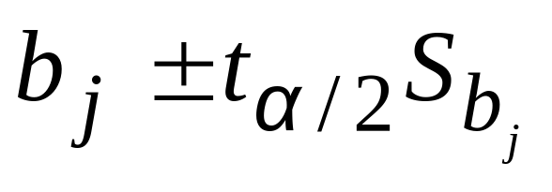
Confidence Interval Estimate for the Slope
Confidence interval for the population slope β_{j}
where t has
(n – k – 1) d.f.
 | Coefficients | Standard Error
Intercept | 306.52619 | 114.25389
Price | -24.97509 | 10.83213
Advertising | 74.13096 | 25.96732
Here, t has
(15 – 2 – 1) = 12 d.f.
Example: Form a 95% confidence interval for the effect of changes in price (X₁) on pie sales:
-24.975 ± (2.1788)(10.832)
So the interval is (-48.576 , -1.374)
(This interval does not contain zero, so price has a significant effect on sales)

Slide 36
Confidence Interval Estimate for the Slope
(continued)
Confidence interval for the population slope β_{j}
 | Coefficients | Standard Error | … | Lower 95% | Upper 95%
Intercept | 306.52619 | 114.25389 | … | 57.58835 | 555.46404
Price | -24.97509 | 10.83213 | … | -48.57626 | -1.37392
Advertising | 74.13096 | 25.96732 | … | 17.55303 | 130.70888
Example: Excel output also reports these interval endpoints:
Weekly sales are estimated to be reduced by between 1.37 to 48.58 pies for each increase of $1 in the selling price, holding the effect of price constant

Slide 37
Testing Portions of the Multiple Regression Model
Contribution of a Single Independent Variable X_{j}
SSR(X_{j} | all variables except X_{j})
  = SSR (all variables) – SSR(all variables except X_{j})
  Measures the contribution of X_{j} in explaining the total variation in Y (SST)

Slide 38
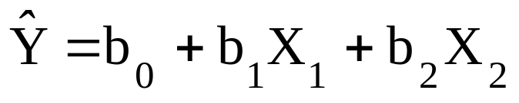
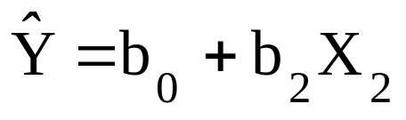
Testing Portions of the Multiple Regression Model
(continued)
Contribution of a Single Independent Variable X_{j}, assuming all other variables are already included
(consider here a 2-variable model):
SSR(X₁ | X₂)
  = SSR (all variables) – SSR(X₂)
From ANOVA section of regression for
From ANOVA section of regression for
Measures the contribution of X₁ in explaining SST

Slide 39
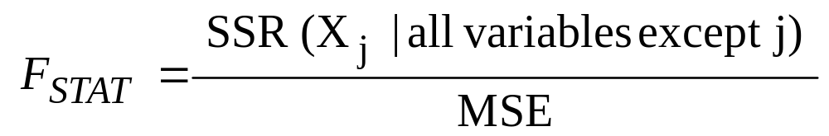
The Partial F-Test Statistic
Consider the hypothesis test:
H₀: variable X_{j} does not significantly improve the model after all
other variables are included
H₁: variable X_{j} significantly improves the model after all other
variables are included
Test using the F-test statistic:
  (with 1 and n-k-1 d.f.)

Slide 40
Testing Portions of Model: Example
Example: Frozen dessert pies
Test at the α = .05 level to determine whether the price variable significantly improves the model given that advertising is included

Slide 41
Testing Portions of Model: Example
(continued)
H₀: X₁ (price) does not improve the model
with X₂ (advertising) included
H₁: X₁ does improve model
α = .05, df = 1 and 12
F_{0.05} = 4.75
(For X₁ and X₂)
(For X₂ only)
ANOVA
 | df | SS | MS
Regression | 2 | 29460.02687 | 14730.01343
Residual | 12 | 27033.30647 | 2252.775539
Total | 14 | 56493.33333
ANOVA
 | df | SS
Regression | 1 | 17484.22249
Residual | 13 | 39009.11085
Total | 14 | 56493.33333

Slide 42
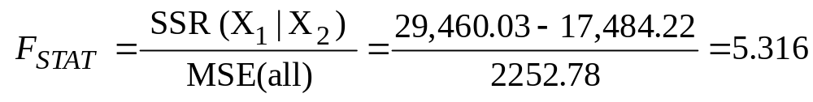
Testing Portions of Model: Example
(continued)
(For X₁ and X₂)
(For X₂ only)
ANOVA
 | df | SS | MS
Regression | 2 | 29460.02687 | 14730.01343
Residual | 12 | 27033.30647 | 2252.775539
Total | 14 | 56493.33333
ANOVA
 | df | SS
Regression | 1 | 17484.22249
Residual | 13 | 39009.11085
Total | 14 | 56493.33333
Conclusion: Since F_{STAT} = 5.316 > F_{0.05} = 4.75 Reject H₀; Adding X₁ does improve model

Slide 43
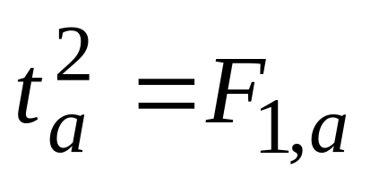
Relationship Between Test Statistics
The partial F test statistic developed in this section and the t test statistic are both used to determine the contribution of an independent variable to a multiple regression model.
The hypothesis tests associated with these two statistics always result in the same decision (that is, the p-values are identical).
Where a = degrees of freedom

Slide 44
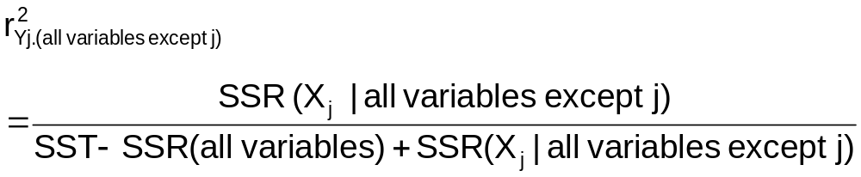
Coefficient of Partial Determination for k variable model
Measures the proportion of variation in the dependent variable that is explained by X_{j} while controlling for (holding constant) the other independent variables

Slide 45
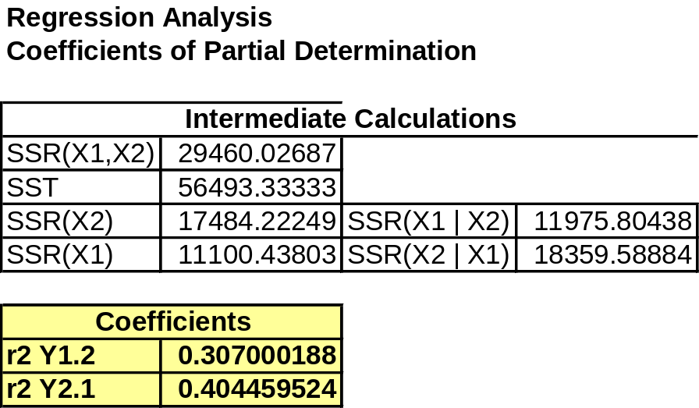
Coefficient of Partial Determination in Excel
Coefficients of Partial Determination can be found using Excel:
  PHStat | regression | multiple regression …
    Check the “coefficient of partial determination” box

Slide 46
Using Dummy Variables
A dummy variable is a categorical independent variable with two levels:
  yes or no, on or off, male or female
  coded as 0 or 1
Assumes the slopes associated with numerical independent variables do not change with the value for the categorical variable
If more than two levels, the number of dummy variables needed is (number of levels - 1)

Slide 47
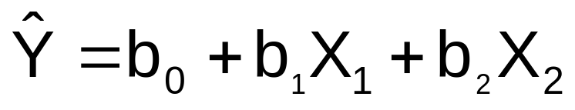
Dummy-Variable Example
(with 2 Levels)
Let:
Y = pie sales
X₁ = price
X₂ = holiday (X₂ = 1 if a holiday occurred during the week) (X₂ = 0 if there was no holiday that week)

Slide 48
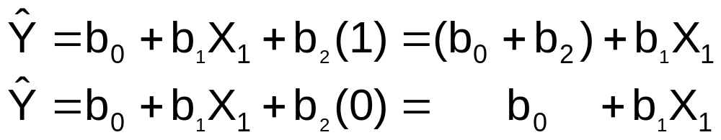
Dummy-Variable Example
(with 2 Levels)
(continued)
Holiday
No Holiday
Different intercept
Same slope
Y (sales)
If H₀: β₂ = 0 is rejected, then
“Holiday” has a significant effect on pie sales
b₀ + b₂
b₀
Holiday (X₂ = 1)
No Holiday (X₂ = 0)
X₁ (Price)

Slide 49
Interpreting the Dummy Variable Coefficient (with 2 Levels)
Example:
Sales: number of pies sold per week
Price: pie price in $
Holiday:
1 If a holiday occurred during the week
0 If no holiday occurred
b₂ = 15: on average, sales were 15 pies greater in weeks with a holiday than in weeks without a holiday, given the same price

Slide 50

Dummy-Variable Models
(more than 2 Levels)
The number of dummy variables is one less than the number of levels
Example:
Y = house price ; X₁ = square feet
If style of the house is also thought to matter:
Style = ranch, split level, colonial
Three levels, so two dummy variables are needed

Slide 51
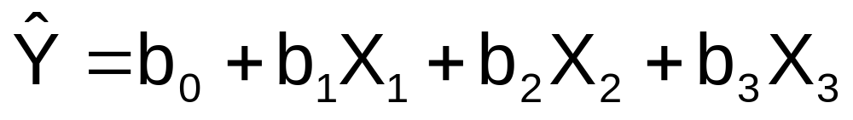
Dummy-Variable Models
(more than 2 Levels)
(continued)
Example: Let “colonial” be the default category, and let X₂ and X₃ be used for the other two categories:
Y = house price
X₁ = square feet
X₂ = 1 if ranch, 0 otherwise
X₃ = 1 if split level, 0 otherwise
The multiple regression equation is:

Slide 52
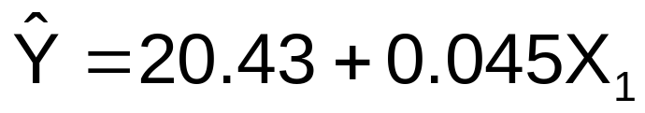
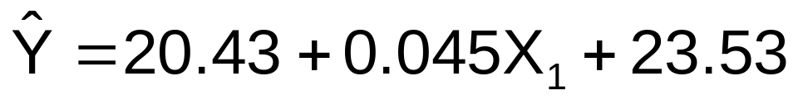
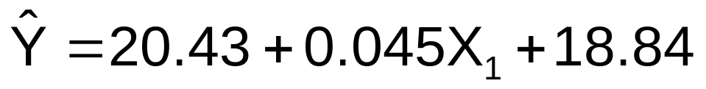
Interpreting the Dummy Variable Coefficients (with 3 Levels)
Consider the regression equation:
For a colonial: X₂ = X₃ = 0
With the same square feet, a ranch will have an estimated average price of 23.53 thousand dollars more than a colonial.
For a ranch: X₂ = 1; X₃ = 0
With the same square feet, a split-level will have an estimated average price of 18.84 thousand dollars more than a colonial.
For a split level: X₂ = 0; X₃ = 1

Slide 53
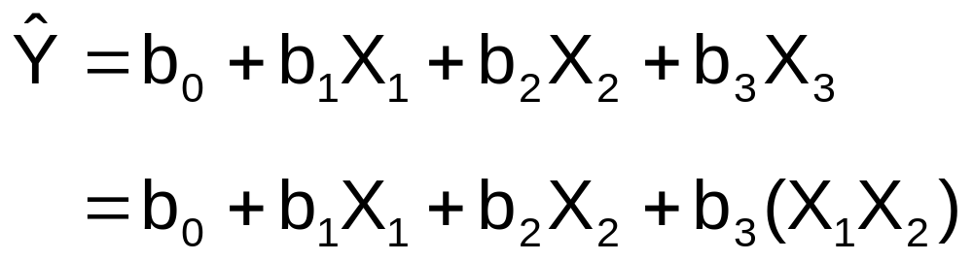
Interaction Between Independent Variables
Hypothesizes interaction between pairs of X variables
  Response to one X variable may vary at different levels of another X variable
Contains two-way cross product terms

Slide 54
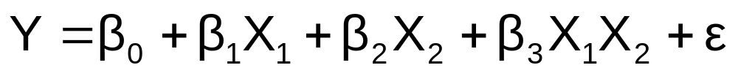
Effect of Interaction
Given:
Without interaction term, effect of X₁ on Y is measured by β₁
With interaction term, effect of X₁ on Y is measured by β₁ + β₃ X₂
Effect changes as X₂ changes

Slide 55

Interaction Example
Suppose X₂ is a dummy variable and the estimated regression equation is
= 1 + 2X₁ + 3X₂ + 4X₁X₂
Y
12
X₂ = 1:
Y = 1 + 2X₁ + 3(1) + 4X₁(1) = 4 + 6X₁
8
4
X₂ = 0:
Y = 1 + 2X₁ + 3(0) + 4X₁(0) = 1 + 2X₁
0
X₁
0
0.5
1
1.5
Slopes are different if the effect of X₁ on Y depends on X₂ value

Slide 56
Significance of Interaction Term
Can perform a partial F test for the contribution of a variable to see if the addition of an interaction term improves the model
Multiple interaction terms can be included
  Use a partial F test for the simultaneous contribution of multiple variables to the model

Slide 57
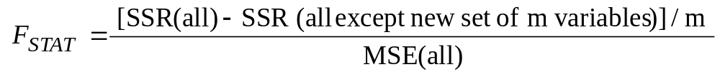
Simultaneous Contribution of Independent Variables
Use partial F test for the simultaneous contribution of multiple variables to the model
  Let m variables be an additional set of variables added simultaneously
  To test the hypothesis that the set of m variables improves the model:
(where F_{STAT} has m and n-k-1 d.f.)

Slide 58
Logistic Regression
Used when the dependent variable Y is binary (i.e., Y takes on only two values)
Examples
  Customer prefers Brand A or Brand B
  Employee chooses to work full-time or part-time
  Loan is delinquent or is not delinquent
  Person voted in last election or did not
Logistic regression allows you to predict the probability of a particular categorical response

Slide 59
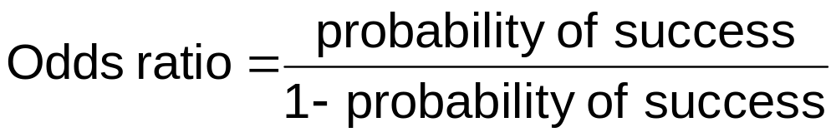
Logistic Regression
(continued)
Logistic regression is based on the odds ratio, which represents the probability of a success compared with the probability of failure
The logistic regression model is based on the natural log of this odds ratio

Slide 60
Logistic Regression
(continued)
Logistic Regression Model:
Where k = number of independent variables in the model
ε_{i} = random error in observation i
Logistic Regression Equation:

Slide 61
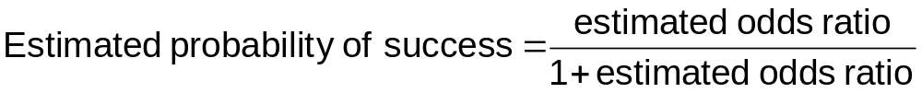
Estimated Odds Ratio and Probability of Success
Once you have the logistic regression equation, compute the estimated odds ratio:
The estimated probability of success is

Slide 62
Chapter Summary
Developed the multiple regression model
Tested the significance of the multiple regression model
Discussed adjusted r²
Discussed using residual plots to check model assumptions
Tested individual regression coefficients
Tested portions of the regression model
Used dummy variables
Evaluated interaction effects
Discussed logistic regression

